Slide 1


Band and Block Brake
by
Dr. Emarti Kumari
Department of Mechanical Engineering
M.B.M. Engineering College
Jai Narain Vyas University, Jodhpur

Slide 2
SYLLABUS:
UNIT 1
Brake: Band brakes, Block brake, Braking action: Effect of braking on vehicle
UNIT 2
Dynamometers: Types and their suitability for power measurement
UNIT 3
Cams: Types of cams and followers, drawing of cam profile for given type of motion and to draw displacement, velocity and acceleration diagrams for a given cam profile
UNIT 4
Governor: Types of governor: Watt, Porters, Proell and spring types, Effect of friction, Controlling force curves, Sensitiveness, Stability, Hunting, Isochronism, Effort of a governor
UNIT 5
Static Force Analysis of Machines: Force body diagram, Static equilibrium, Principle of virtual work, Static forces analysis in a machines; Slides Crank mechanism, Four bar linkage, Shaper Mechanism, Gyroscopic motion and elementary concepts of ship stabilization , Stability of automotive vehicle

Slide 3
Function of Brakes and Dynamometers:
The primary function of a Brake is either to bring to rest a body which is in motion or to hold a body in a state of rest or of uniform motion against the action of external forces or couples.
The primary function of a dynamometer is to measure the forces or couples which tend to change the state of rest or of uniform motion of a body.
Difference between a brake and a dynamometer is often one of purpose rather than of principle; an arrangement which is used as a brake may frequently be made to serve as a dynamometer with the addition of a force measuring device, such as a deadweight or spring balance.

Slide 4
Classification of Brakes:
Air brakes: Air brakes are used in trucks, buses, trailers, and semi-trailers. George Westinghouse first developed air brakes for use in railway service. He patented a safer air brake on March 5, 1872.
Hydraulic brakes: The hydraulic brake is an arrangement of braking mechanism which uses brake fluid, typically containing ethylene glycol, to transfer pressure from the controlling unit. In 1918 Malcolm Lougheed developed a hydraulic brake system.
Electrical brake: Electric brakes are used in electrically driven utilities and machines in industries and mainly in electric automotive such as electric locos. This was designed as an alternative to the conventional braking system of applying friction over the wheels to slow them.
Electromagnetic brakes: operate electrically, but unlike eddy current brakes, transmit torque mechanically.

Slide 5
Classification of Brakes Contd…:
Mechanical brake: In mechanical brake friction force is applied by giving pressure on the surface of drum or disk. It may further divided axial brake and radial brake as per the direction of force acting on drum. Radial break may internal or external.
According to shape of friction element, it may further divided in to block / shoe break, band break, disk break.
Disc brakes: A brake disc is usually made of cast iron, reinforced carbon-carbon or ceramic matrix composites. This is connected to the wheel and/or the axle. To stop the wheel, friction material in the form of brake pads (mounted on a device called a brake caliper) is forced Mechanically, hydraulically, pneumatically or electromagnetically against both sides of the disc.

Slide 6
Brake Material
The coefficient of friction should remain constant with change in temperature.
It should have low wear rate.
It should have high heat resistance.
It should have high heat dissipation capacity.
It should have adequate mechanical strength.
It should not be affected by moisture and oil.

Slide 7
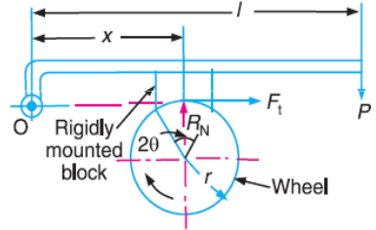
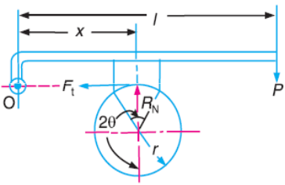
Simple Block or Shoe Brake
A single block or shoe brake is shown in Fig. 1. It consists of a block or shoe which is pressed against the rim of a revolving brake wheel drum. The block is made of a softer material than the rim of the wheel. This type of a brake is commonly used on railway trains and tram cars. The friction between the block and the wheel causes a tangential braking force to act on the wheel, which retard the rotation of the wheel. The block is pressed against the wheel by a force applied to one end of a lever to which the block is rigidly fixed as shown in Fig. 1. The other end of the lever is pivoted on a fixed fulcrum O.
(a) Clockwise rotation of brake wheel
(b) Anticlockwise rotation of brake wheel
Fig. 1 single shoe brake

Slide 8
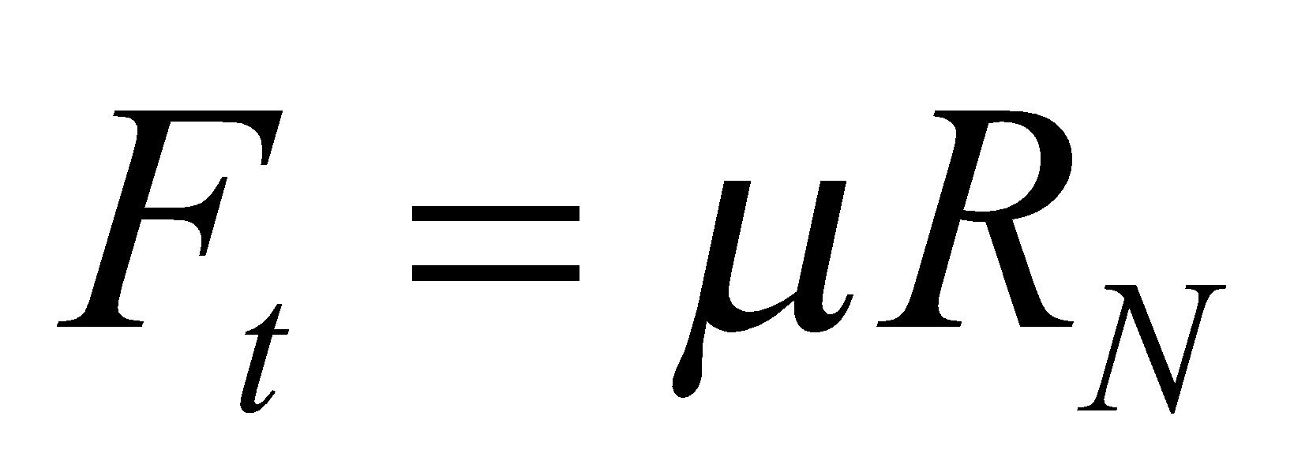
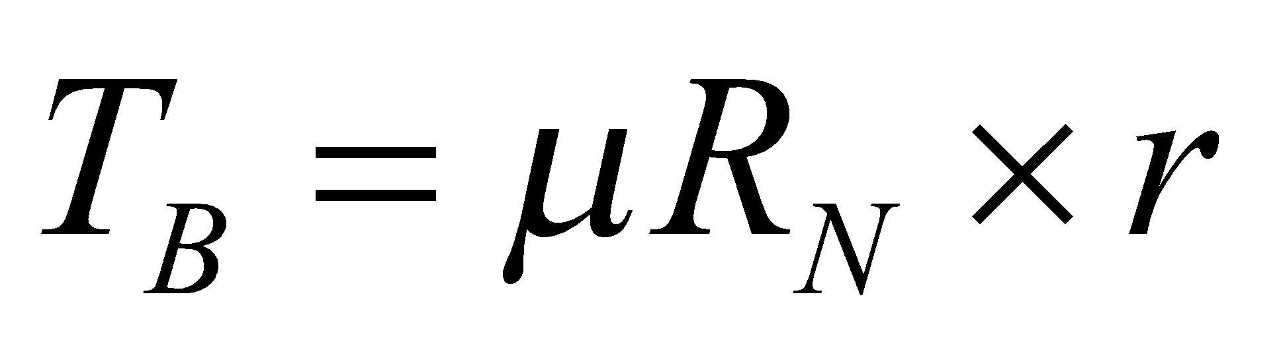
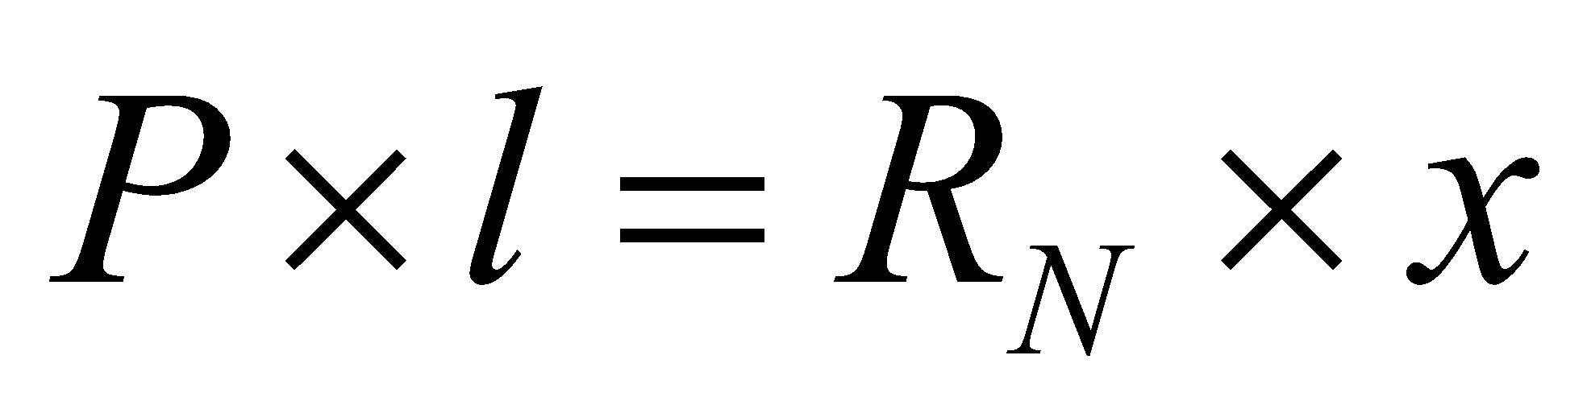
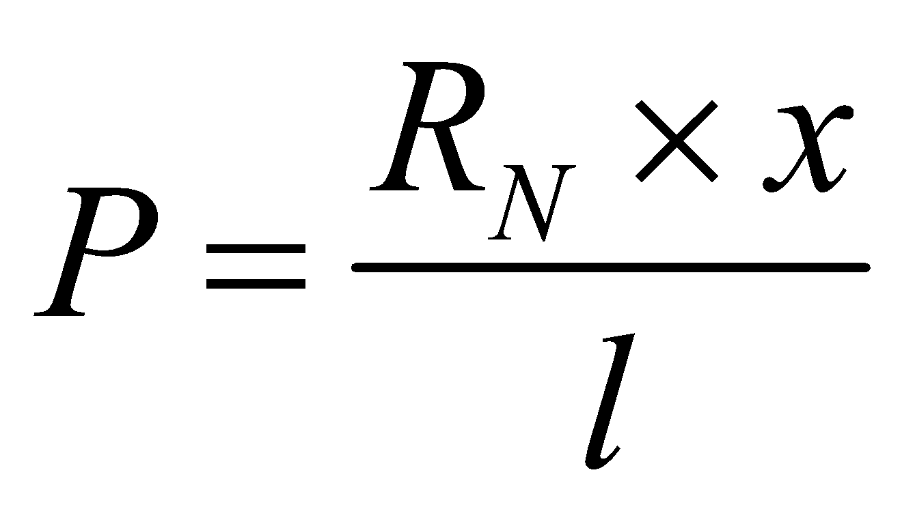
Simple Block or Shoe Brake contd…
P = Force applied at the end of the lever R_{N}= Normal force pressing the brake block on the wheel r = Radius of the wheel 2θ = Angle of contact surface of the block µ = Coefficient of friction F_{t} = Tangential braking force or the frictional force acting at the contact surface of the block and the wheel.
Braking Torque on the drum = Frictional Force x radius
Fig. 2 clockwise rotation of shoe brake
If the pivot lies on the line of action of Ft at O, a = 0 and
Which is valid for clockwise as well as anticlockwise rotation of drum.

Slide 9
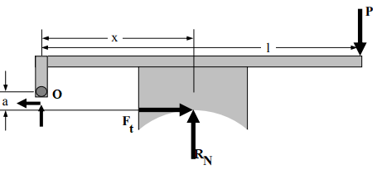
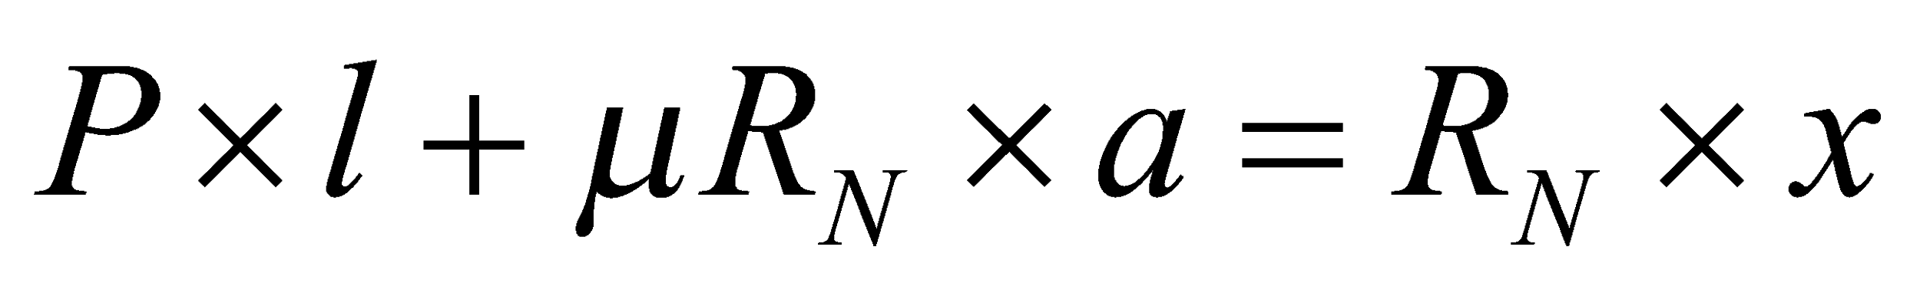
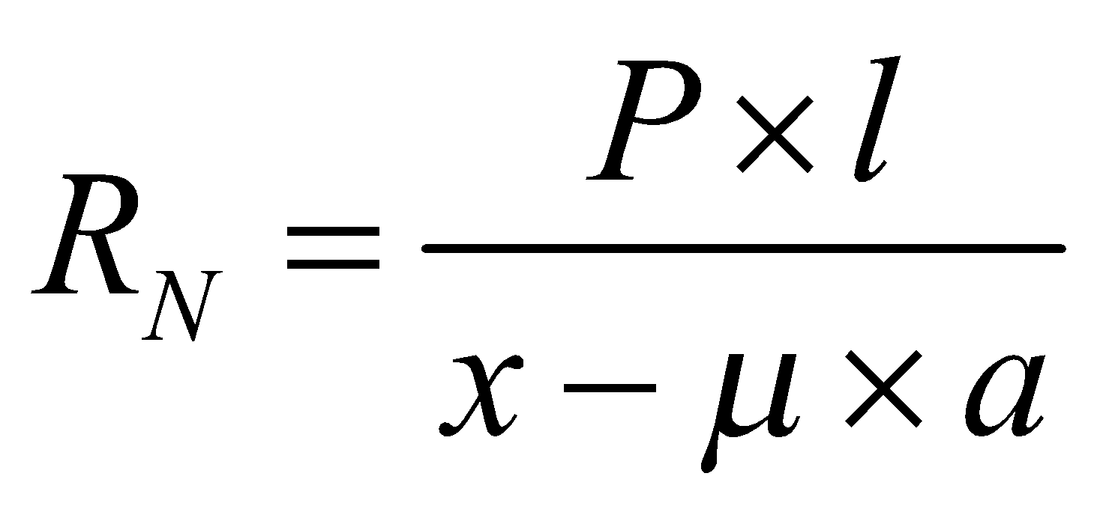
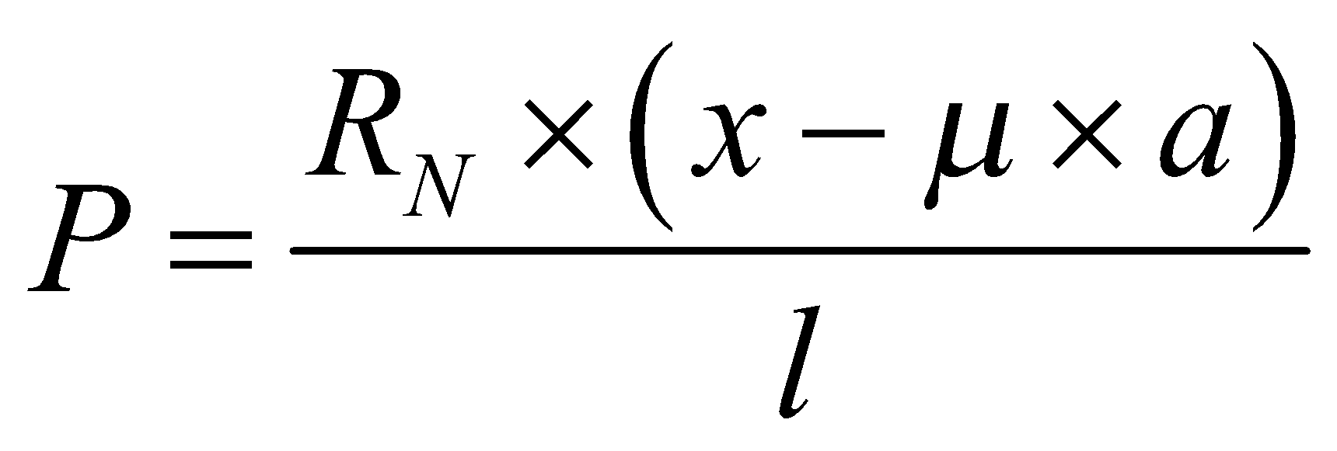
Simple Block or Shoe Brake contd…
The direction of the frictional force on the drum is to be opposite to that of its rotation while on the block it is in the same direction.
Taking moments about the pivot O:
Fig. 3 anticlockwise rotation of shoe brake with friction force
When x = μa, P = 0, which implies that the force needed to apply the brake is virtually zero, or that once contact is made between the block and the drum, the break is applied itself. Such a brake is known as self-locking brake. This is the condition for self-locking.

Slide 10
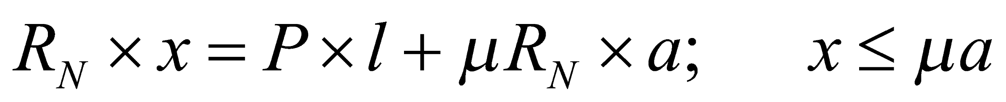
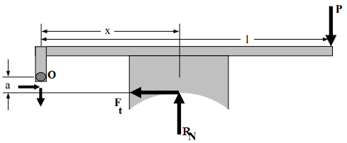
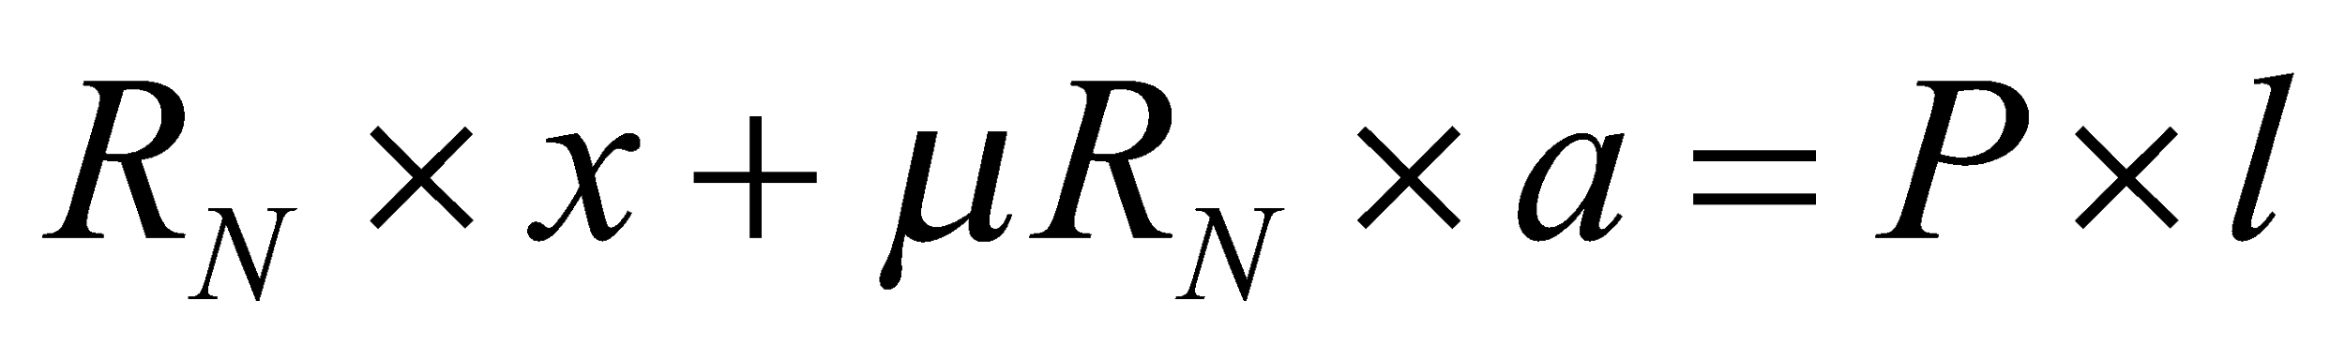
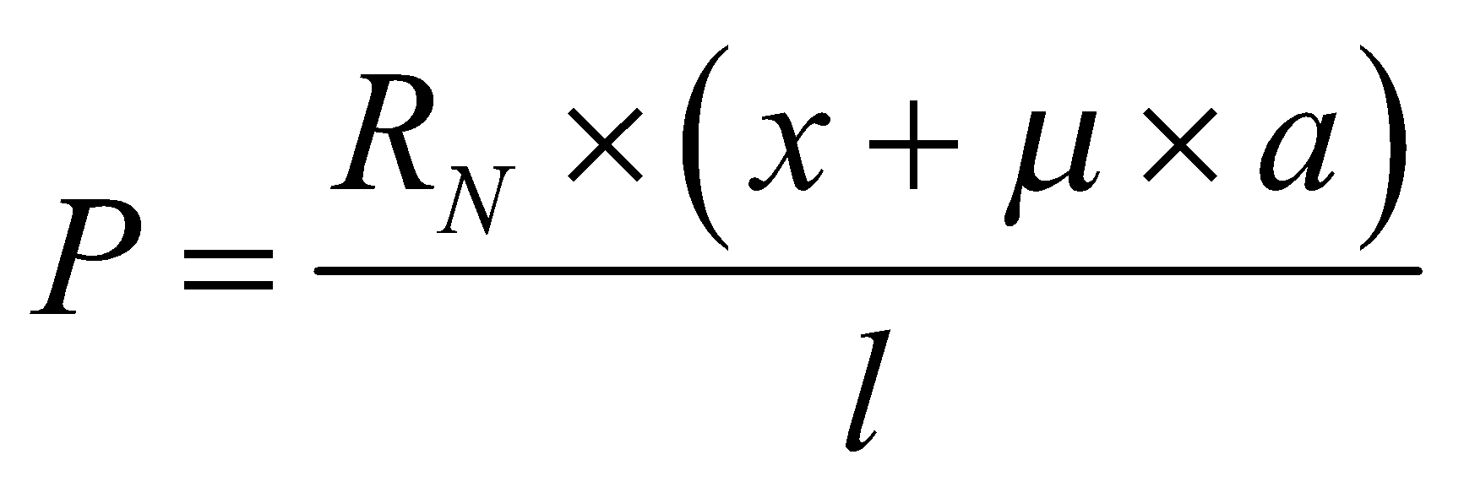
Simple Block or Shoe Brake contd…
The frictional force F_{t} adds to a moment of force (P x l) about O is in the same direction as that of the applied force P than frictional force F_{t} aids in applying the brake. Such a brake is known as self-energised brake.
It the rotation of drum is reversed, it is made anticlockwise:
Fig. 4 clockwise rotation of shoe brake with friction force
When the direction of rotation is changed, the moment of frictional force now will be opposing the actuation force and hence greater magnitude of force is needed to create the same contact pressure P. The shoe on which this is prevailing is known as a trailing shoe.

Slide 11
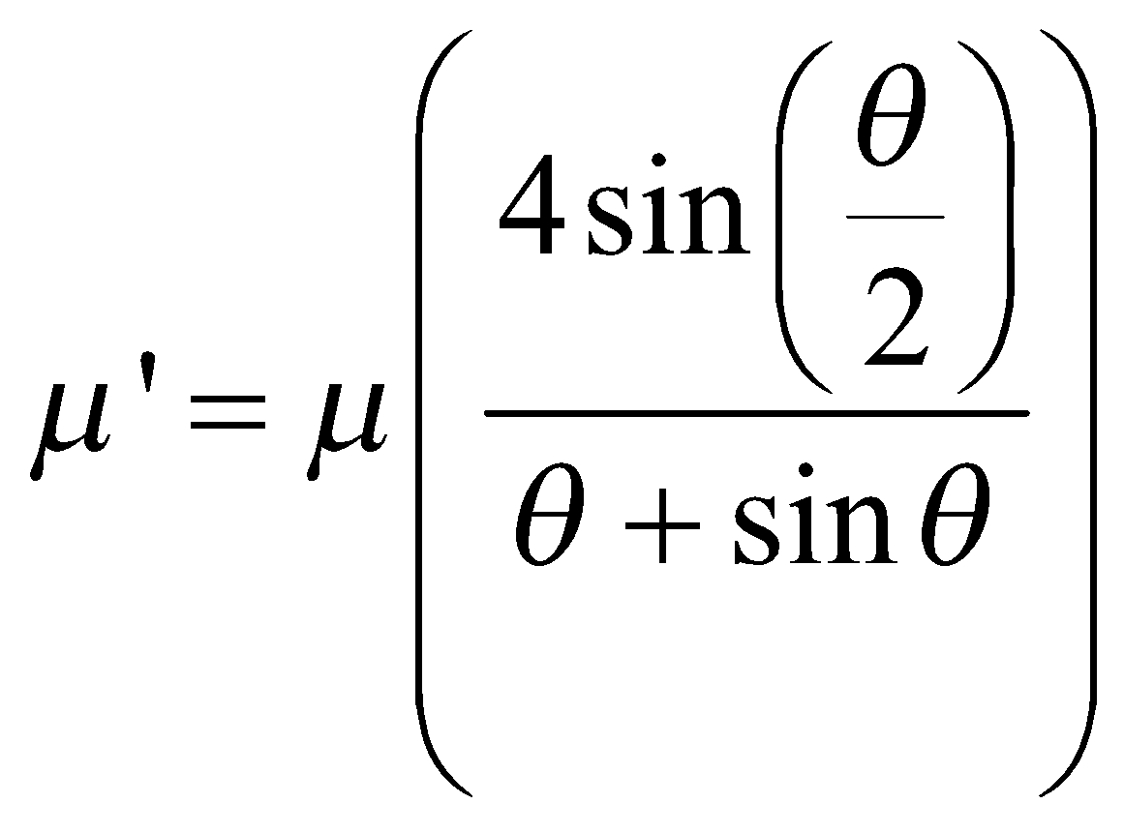
Simple Block or Shoe Brake contd…
In the above calculations, it is assumed that the normal reaction force and frictional force act at the mis-point of the block. However, this is true only for small angles of contact. When the angle of contact is more than 40° the normal pressure is less at the ends than at the centre. In that case, μ has to be replaced by an equivalent coefficient of friction μ’ written by:

Slide 12
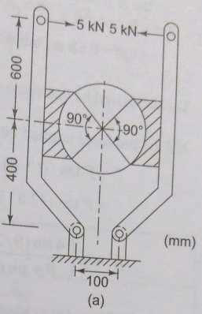
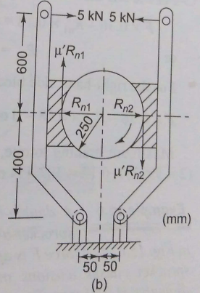
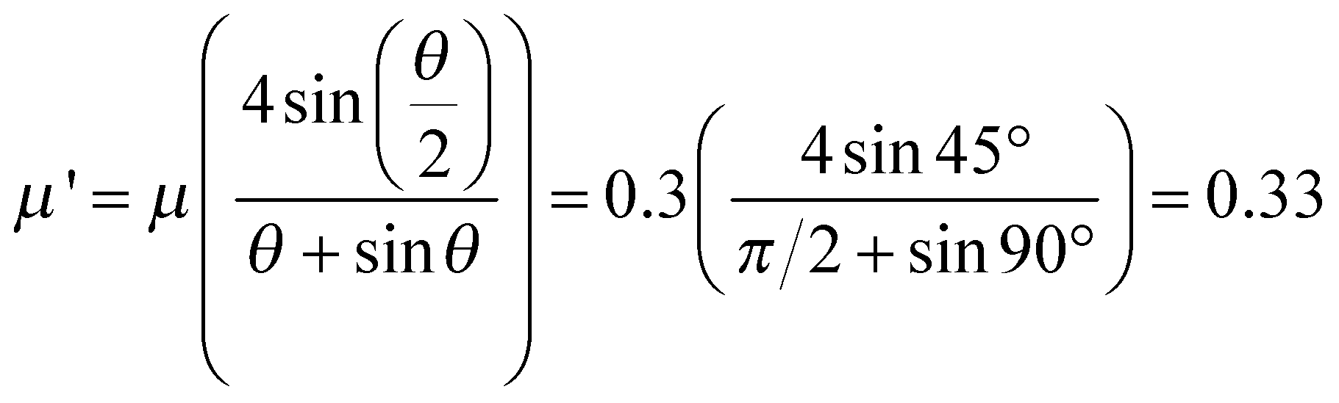
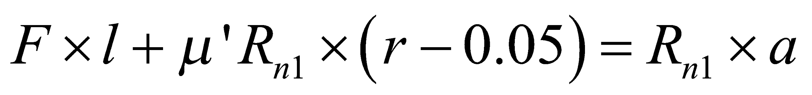
Problem 1. A spring-operated pivoted shoe brake is shown in Fig. is used for a wheel diameter of 500 mm. The angle of contact is 90° and the coefficient of friction is 0.3. The force applied by the spring on each arm is 5 kN. Determine the brake torque on the wheel.
Solution: P = 5000 N, d = 500 mm, r = 250 mm, μ = 0.3
Assuming rotation is clockwise, the various forces acting on the two blocks is shown in Fig.
Angle of contact is more than 40°, thus
Fig. 5 double shoe brake
For the left-hand side block, taking moment about O₁:

Slide 13
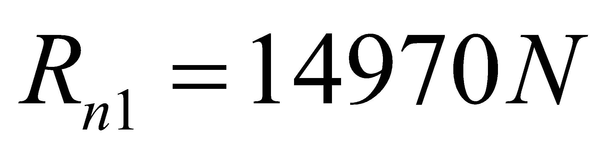
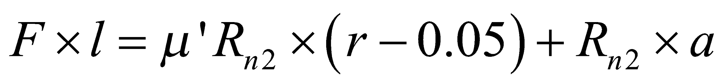
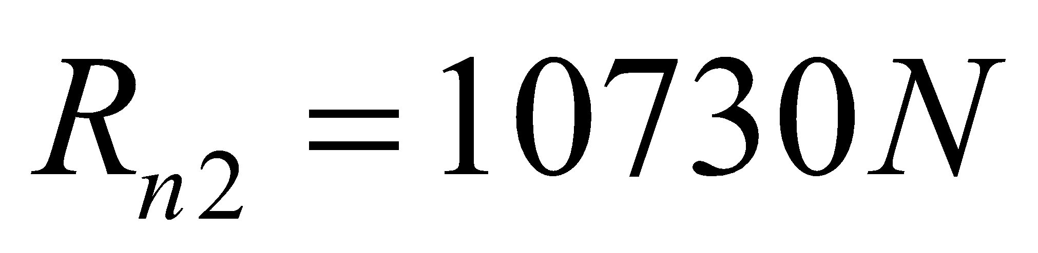
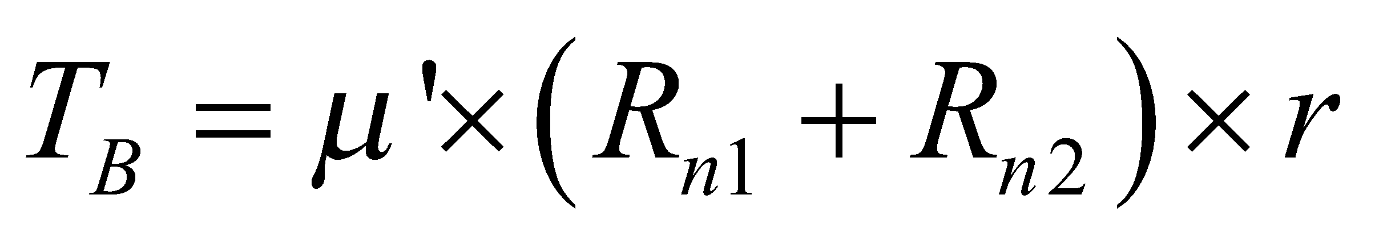
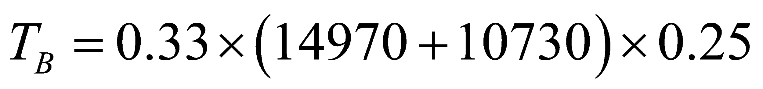
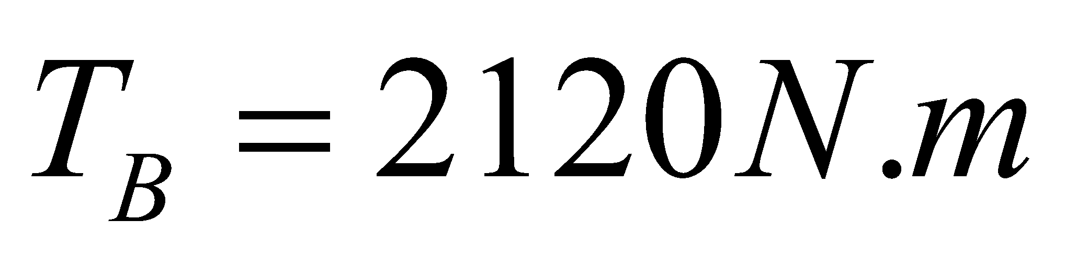
For the right-hand side block, taking moment about O₂:

Slide 14
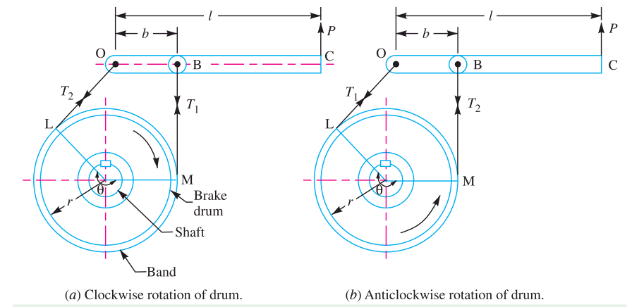
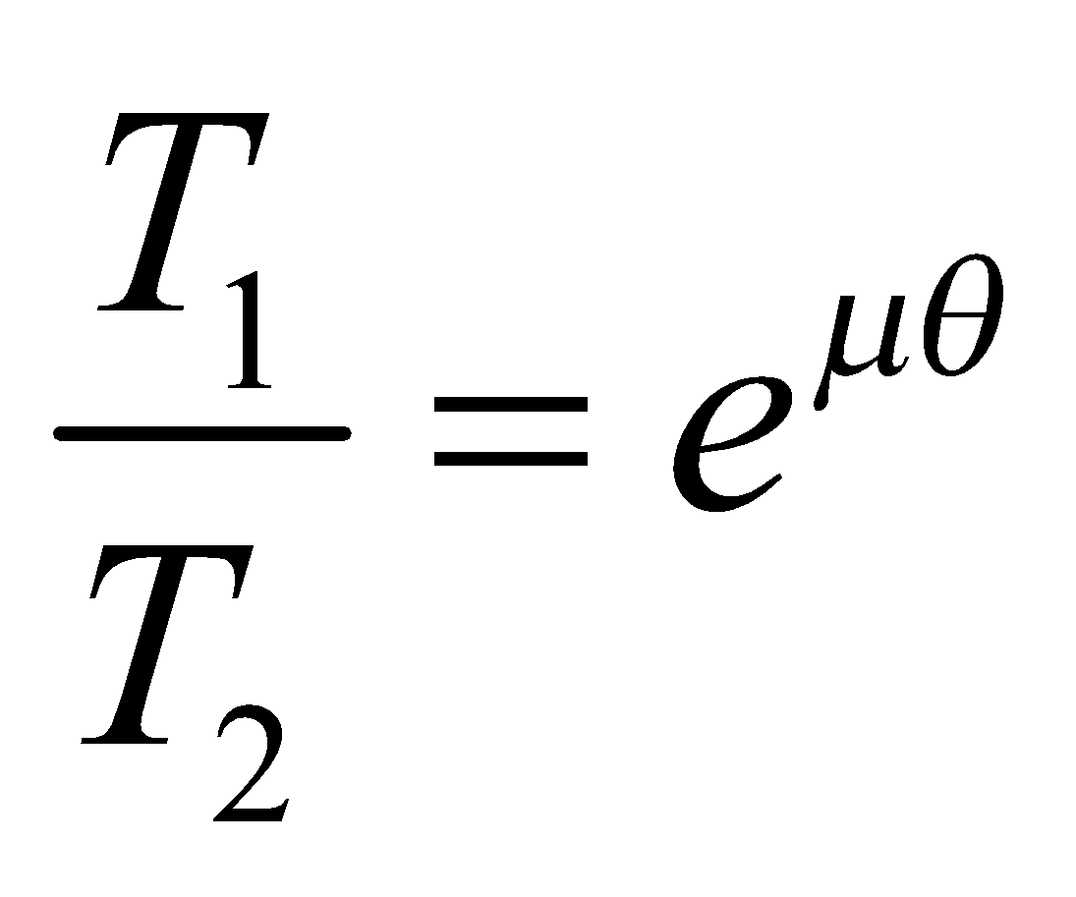
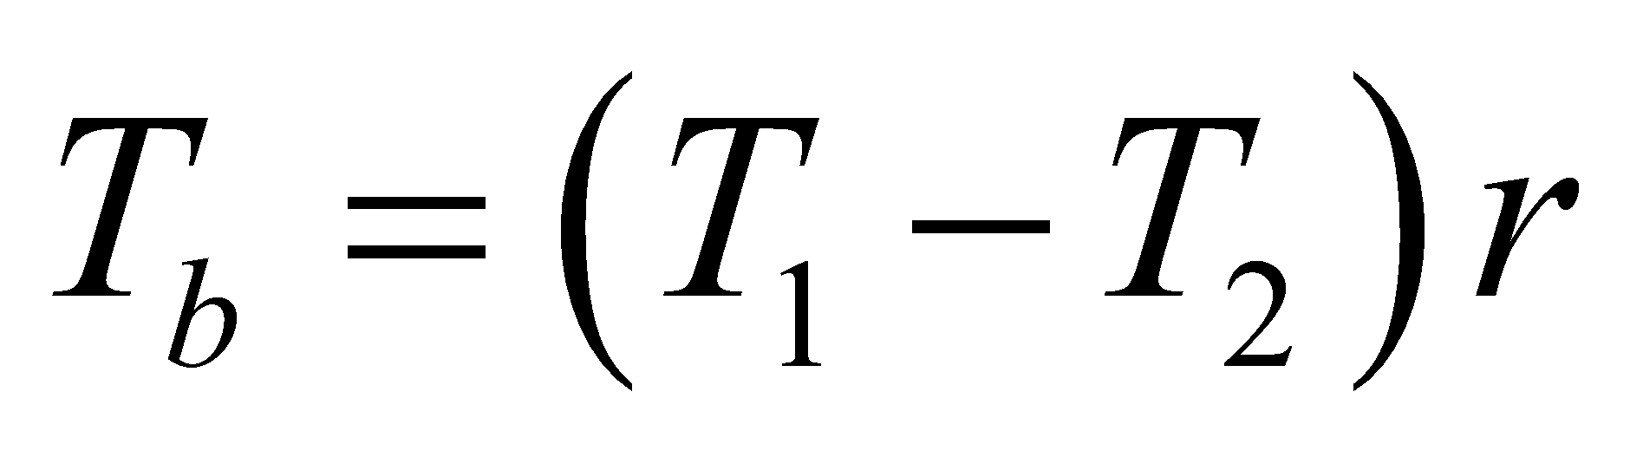
2. Band Brake:
The band brake may be classified as: (a) simple band brake (b) differential band brake
(a) simple band brake:
Let T₁ and T₂ be the tension on the tight and slack sides, respectively. Taking the moment about the fulcrum, we have:
Pl = T₁b, for the clockwise rotation of the drum
Pl = T₂b, for the anti-clockwise rotation of the drum
Braking torque on the drum:
Fig. Band Brake

Slide 15
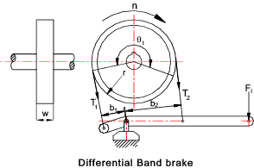
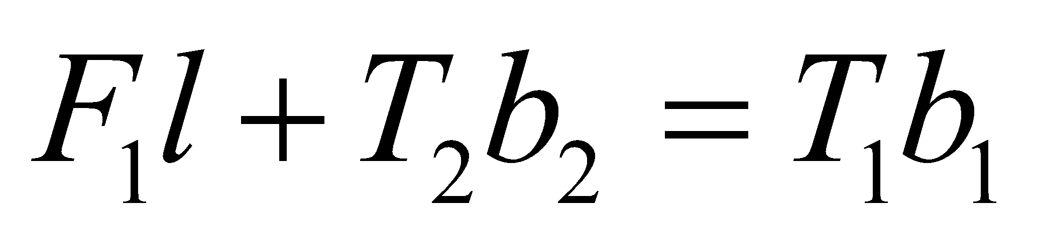
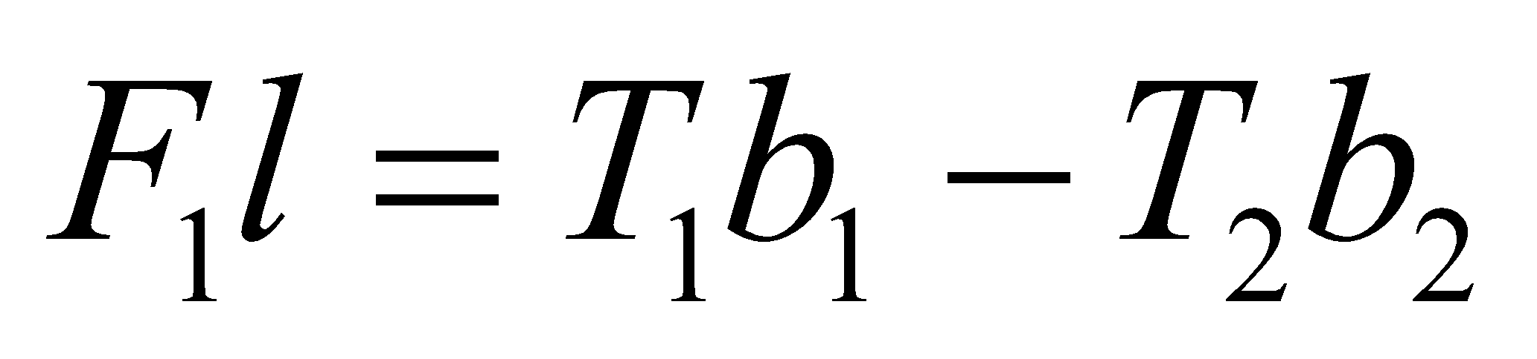
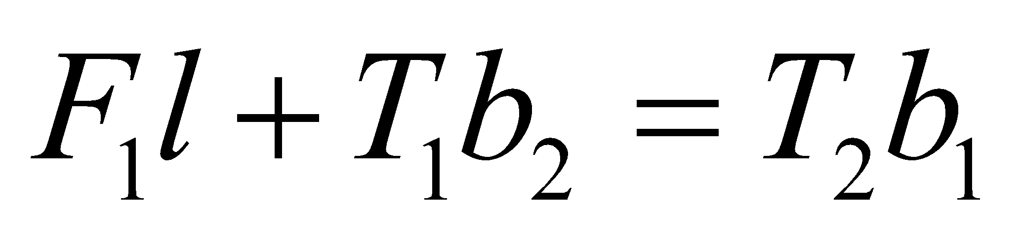
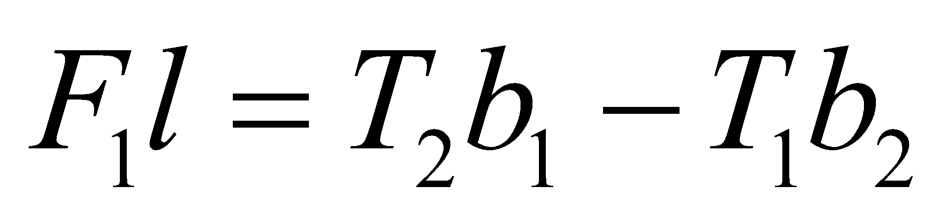
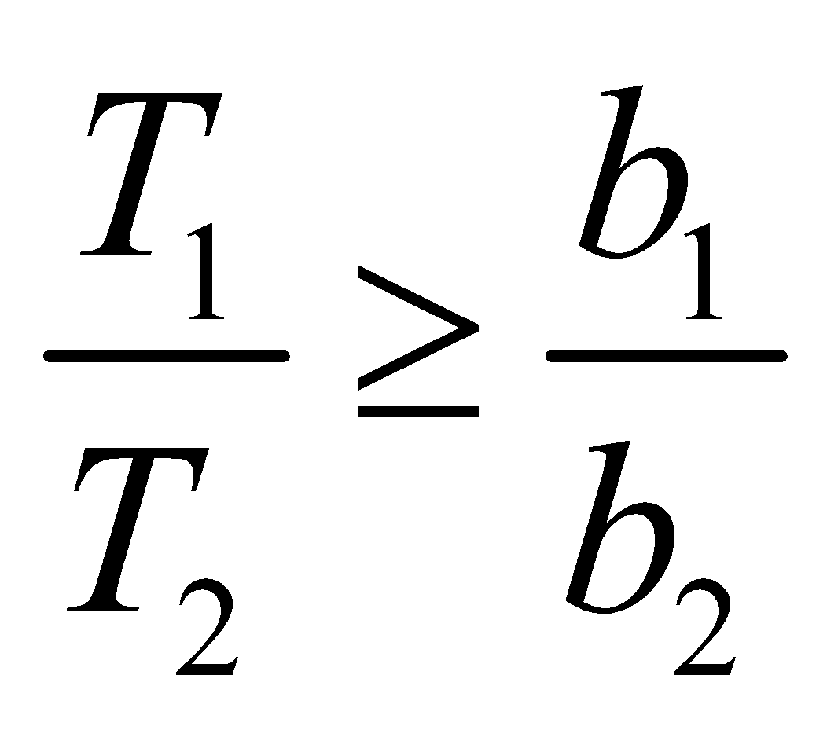
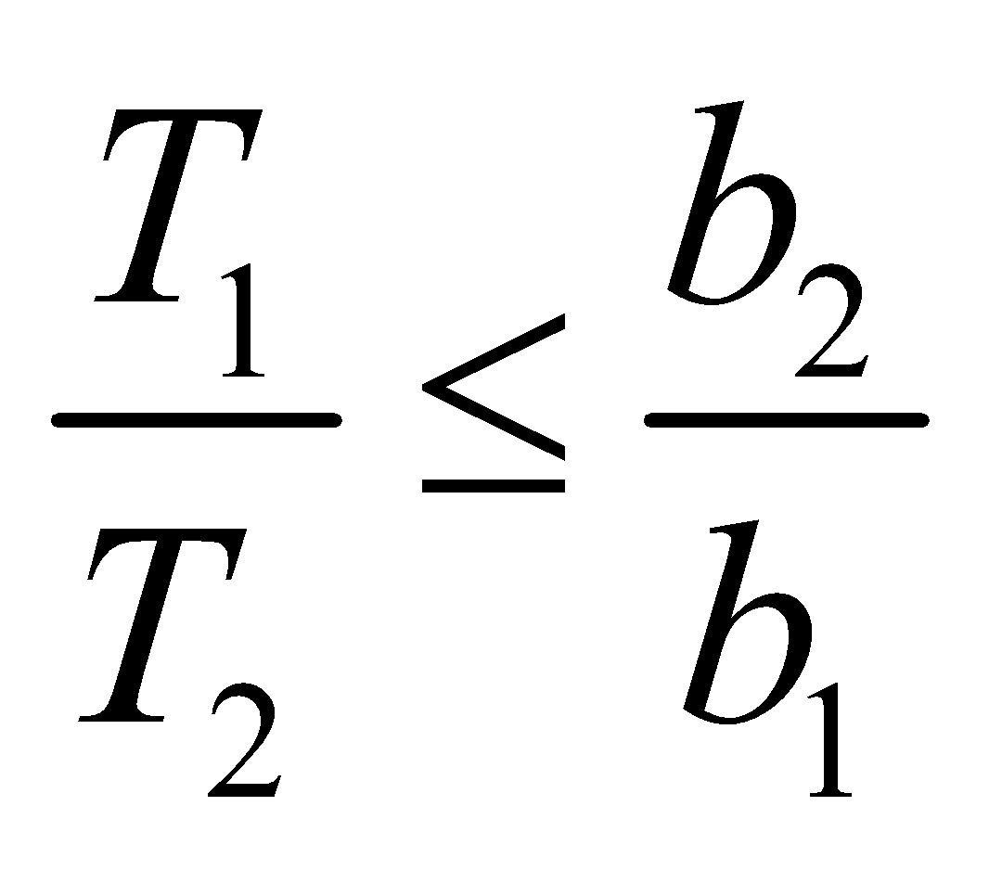
Band Brake contd…
(b) differential band brake:
Taking the moment about the fulcrum, we have:
, for the clockwise rotation of the drum
, for the counter-clockwise rotation of the drum
For the self-locking brake, Applied Effort F₁ ≤ 0, therefore, for the counter-clockwise rotation:
And for the clockwise rotation:

Slide 16
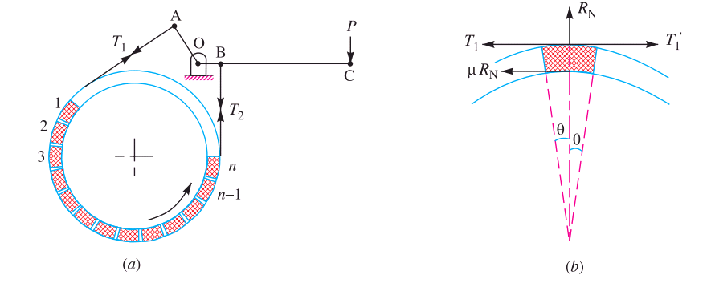
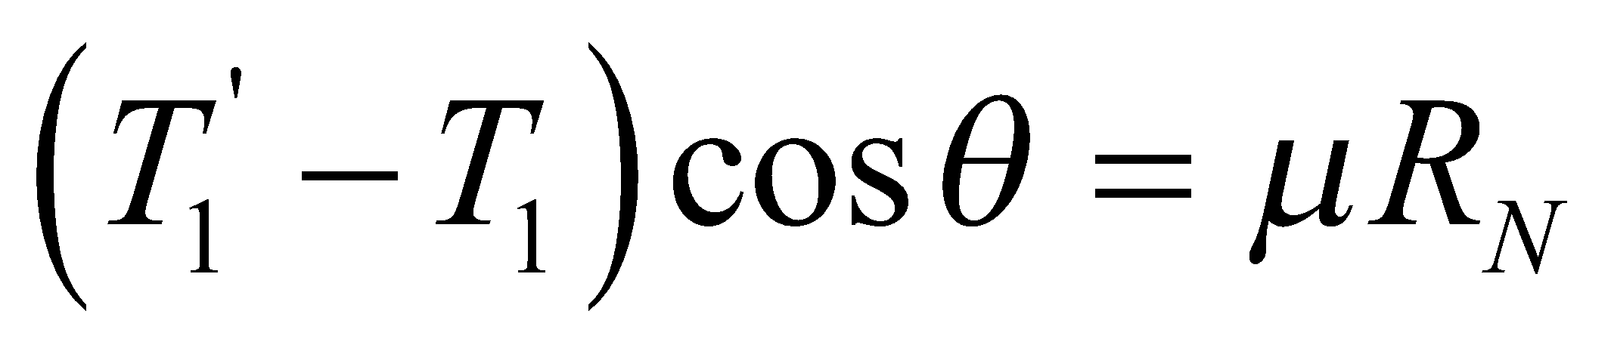
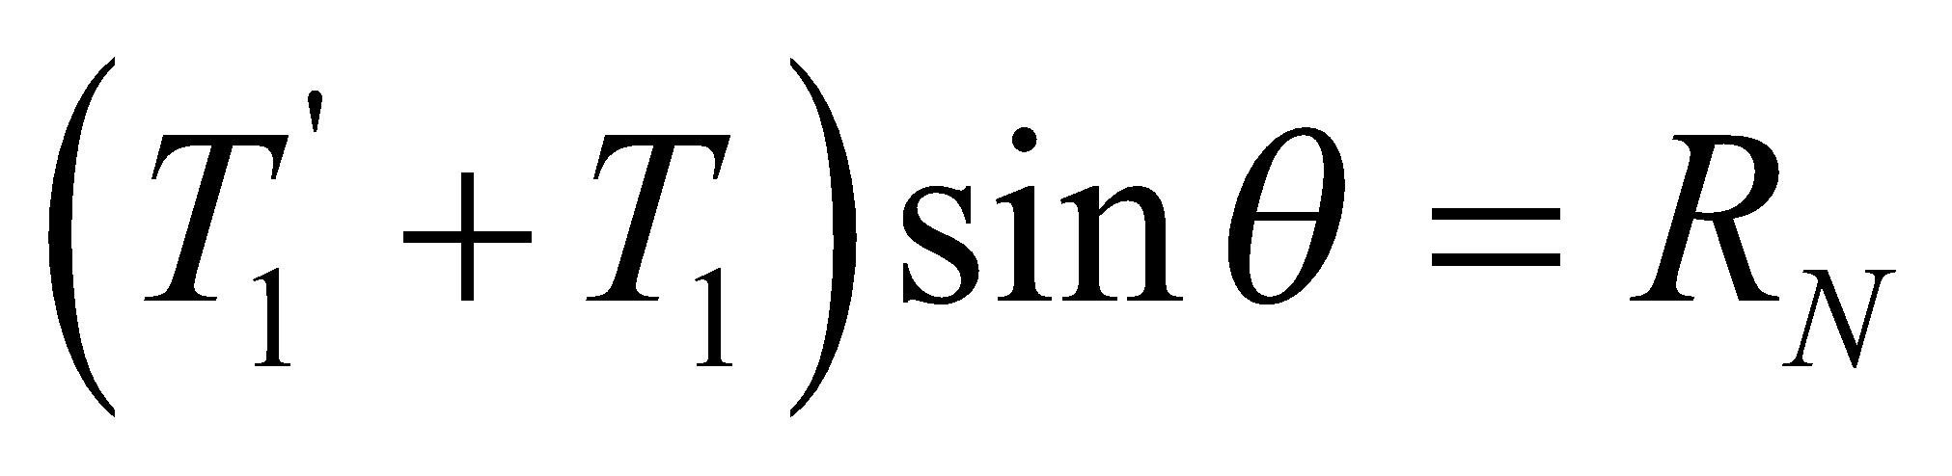
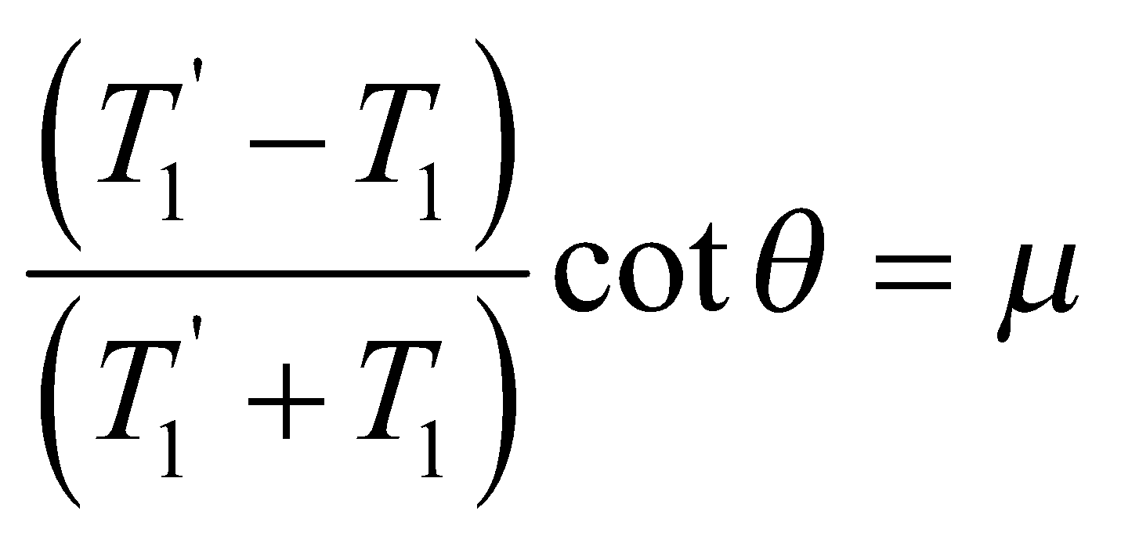
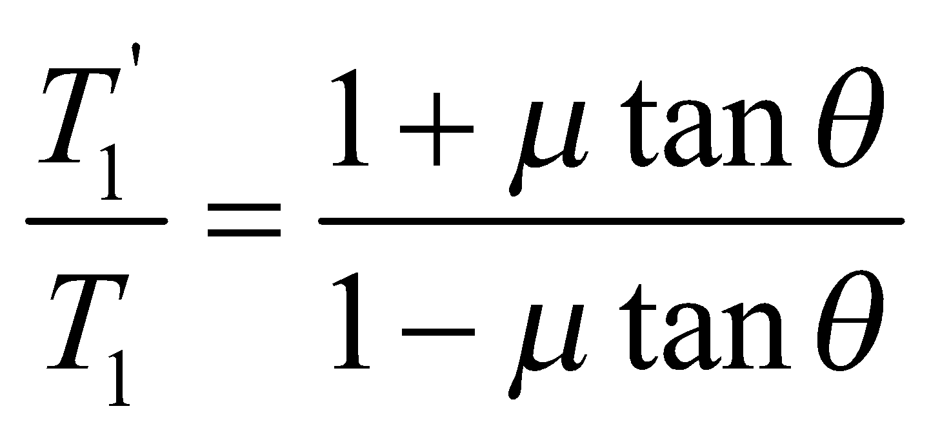
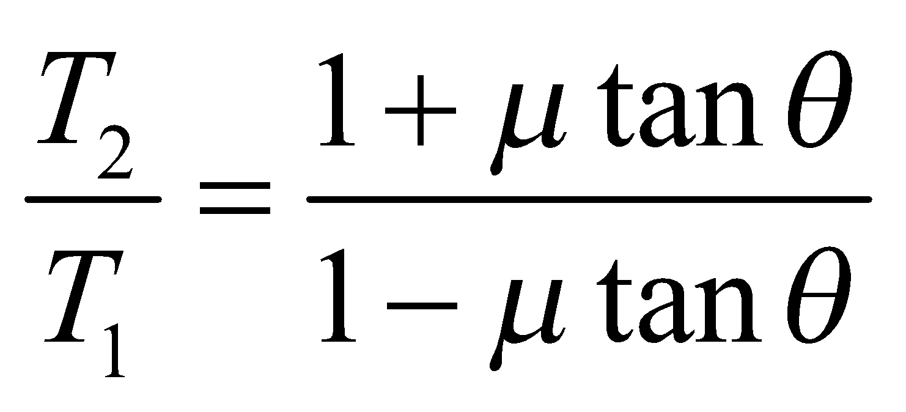
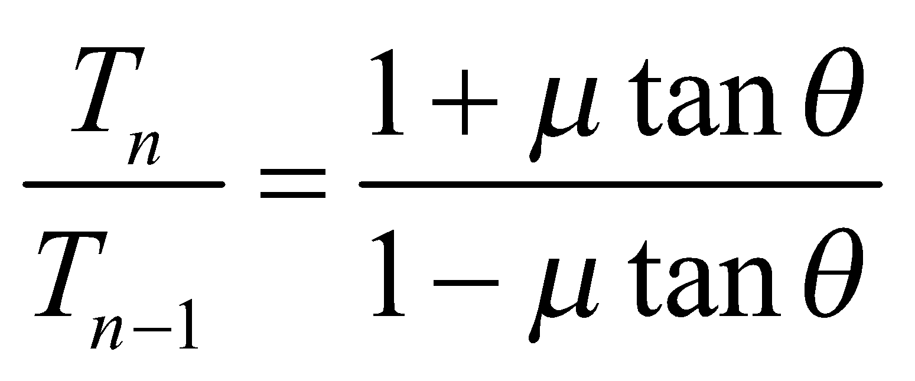
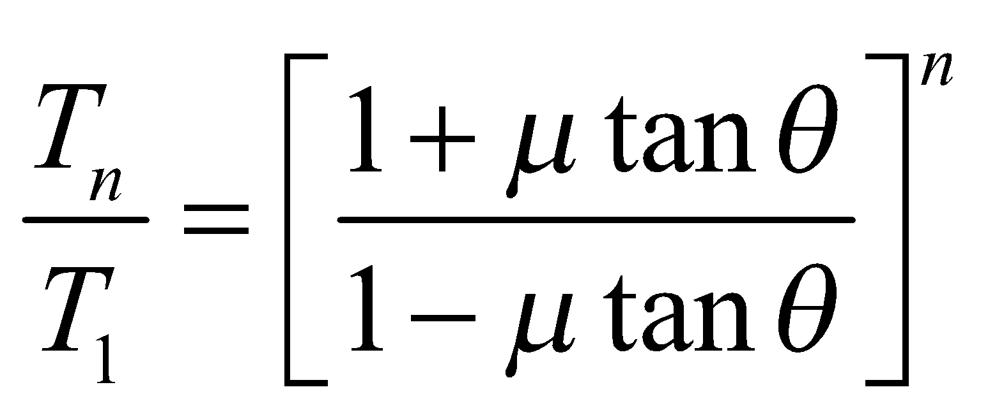
3. Band and Block Brake:
The forces acting on the first block are Shown in Fig. (b). Resolving the forces horizontally and vertically, we get:
or
Similarly
Hence,
Fig. Band and Block Brake
Braking torque,

Slide 17
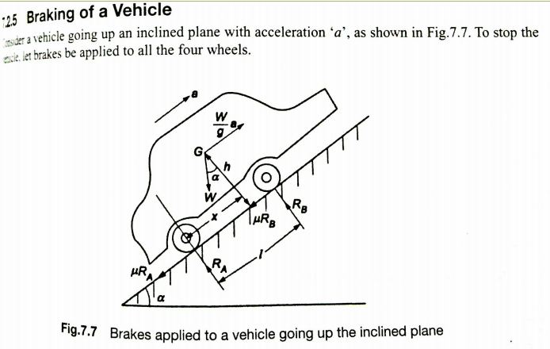

Slide 18
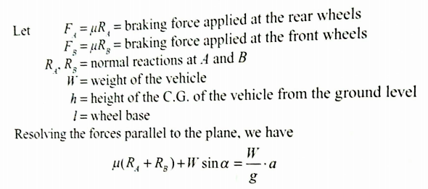
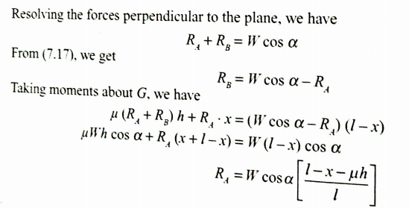

Slide 19
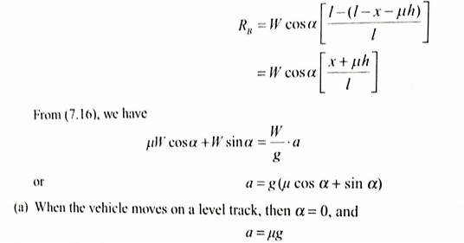

Slide 20
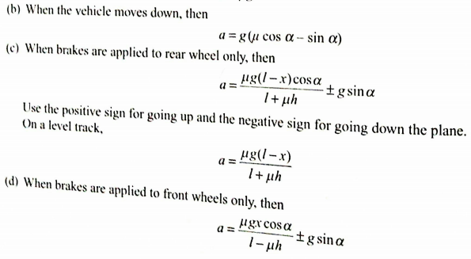

Slide 21
Thank You

